Slide 1
Board Orientation
Notes:
Introduce self
Thank you for the opportunity to speak about SOIA

Slide 2
The Big Picture

Slide 3
Mission Statement
The mission of Special Olympics is to provide year-round sports training and athletic competition in a variety of Olympic-type sports for children and adults with intellectual disabilities, giving them continuing opportunities to develop physical fitness, demonstrate courage, experience joy and participate in a sharing of gifts, skills, and friendship with their families other Special Olympics athletes and the community.

Slide 4
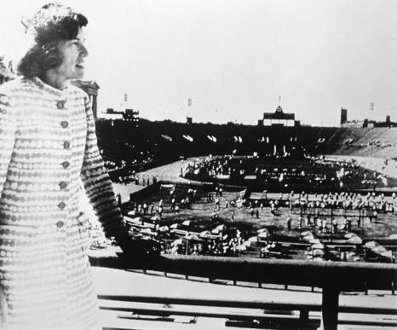
History of Special Olympics International
"The right to play on any playing field?
You have earned it.
The right to study in any school?
You have earned it.
The right to hold a job?
You have earned it?
The right to be anyone's neighbor?
You have earned it.“
The days of segregation and separation are over!
You Special Olympians have thrilled us on the playing fields of the world. You have taught us that what matters is not power or politics, weapons or wealth. What truly counts is the courageous spirit, the generous heart.
Like the heart of the mother whose daughter is special. She walked with her child 16 miles each week from her village to the coach who taught her daughter how to run. This mother is in the stadium tonight and tomorrow, with the world watching, she will she her daughter race in the 200 meter dash. When our hearts are touched.
World Games 1987
Mrs. Eunice Kennedy Shriver, Founder
Shriver Camp - Summer Day Camps
Soldier Field - First International Summer Games
1st National Games
Held in Ames, Iowa in 2006

Slide 5
Worldwide Movement
172 Countries
435,107Coaches
1,156,397 Volunteers 4,931,754 Athletes
725,898 Unified Partners
108,821 competitions- 298 per day
*2016 Reach Report from Special Olympics
The world’s leading public health organization for people with intellectual disabilities
A culture of athlete leadership
The world’s leading voice in elevating awareness of the needs and abilities of people with intellectual disabilities

Slide 6
History of Special Olympics Iowa
Statewide Nonprofit Organization
Founded in 1968
Iowa’s 1st team had fewer than 100 participating athletes
State Office building opened in 2004
Rented office space prior to this
Currently providing over 14,500 athlete experiences to individuals with intellectual disabilities and Unified Sports Partners in all 99 counties of Iowa
*2017 Special Olympics Iowa Reach Report

Slide 7
Who We Serve

Slide 8
Who can participate?
An individual with a medically diagnosed intellectual disability
Individuals without an intellectual disability can participate as Unified Sports® Partners
Young Athletes Program for those 2 – 7 years of age to learn skills and gain introduction to sports.
Must be 8 years of age or older to participate in competitions
No ending age limit

Slide 9
By the Numbers
14,961 Athletes
18,625 Volunteers
23 Olympic Style Sports
*2017 Special Olympics Iowa Reach Report

Slide 10
Summer Games
Held annually in the month of May in Ames
Bocce & Bocce Skills
Cycling
Developmental events
Soccer & Soccer Skills
Swimming
Tennis (Doubles & Singles)
Track & Field
3000+ Participants
1500+ Volunteers

Slide 11
Winter Games
Held annually in the month of January in Dubuque
Alpine Skiing (Downhill)
Figure Skating
Nordic Skiing (Cross Country)
Snowshoeing
Speed Skating
300+ Participants
250+ Volunteers

Slide 12
Mid-Winter Tournament
Held annually in the month of March in Iowa City
Basketball
Skills
3 on 3
5 on 5
Cheerleading
Gymnastics
Powerlifting
1,100+ Participants
380+ Volunteers

Slide 13
Additional State Competitions
Softball
Held annually in the month of Augustin Ankeny
25+ Teams
Equestrian
Held annually in the month of September in Granger
60+ Participants
Volleyball
Held annually in the month of October in Ames
300+ Participants
Flag Football
Held annually in the month of October in Cedar Rapids
14+ Teams
Bowling
Held annually in the month of November in Cedar Rapids, Council Bluffs and Des Moines
3,500+ athletes train at area level
800+ compete in State Bowling Tournaments

Slide 14
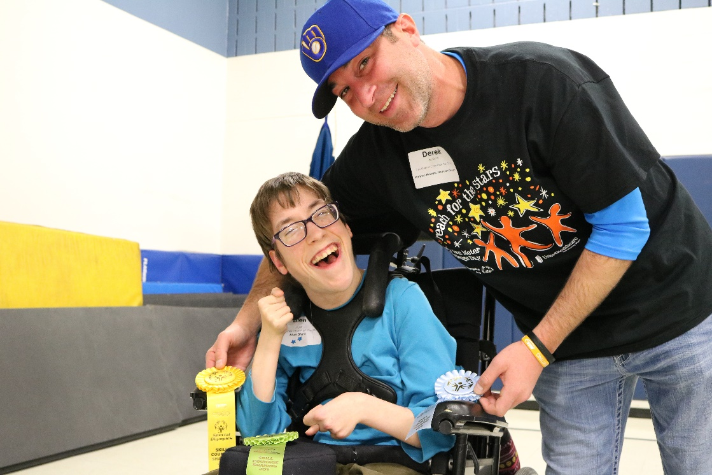
Challenge Days
Specialized adaptive equipment is used for the athletes
Designed to serve athletes with the most severe and profound disabilities and our aging population
400+ participants
Held annually in:
Cedar Falls
Des Moines
Dubuque
Emmetsburg
Glenwood
Lake City/Carroll
River Hills

Slide 15
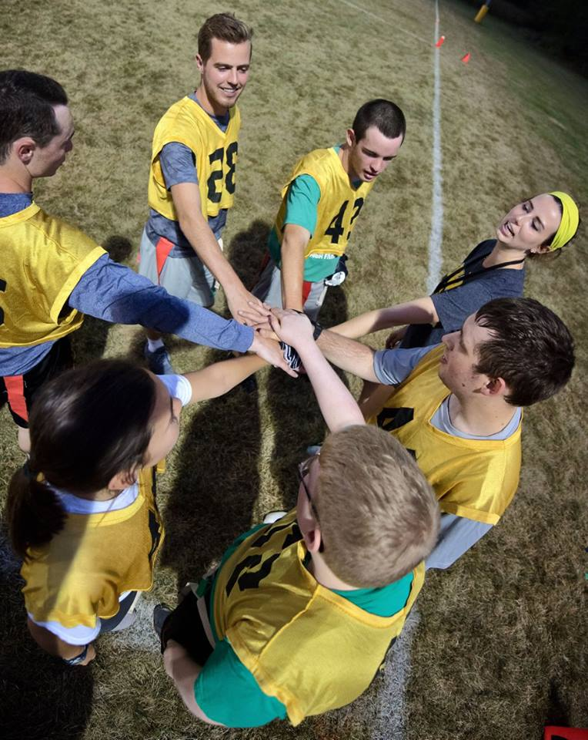
Unified Programs
This program pairs athletes with intellectual disabilities to those without.
Competitions include:
Basketball
Bowling
Cheerleading
Cycling
Flag Football
Golf
Figure & Speed Skating
Snowshoeing
Soccer
Softball
Tennis
Track & Field
Volleyball
8,300+ participants
*2017 Special Olympics Iowa Reach Report

Slide 16
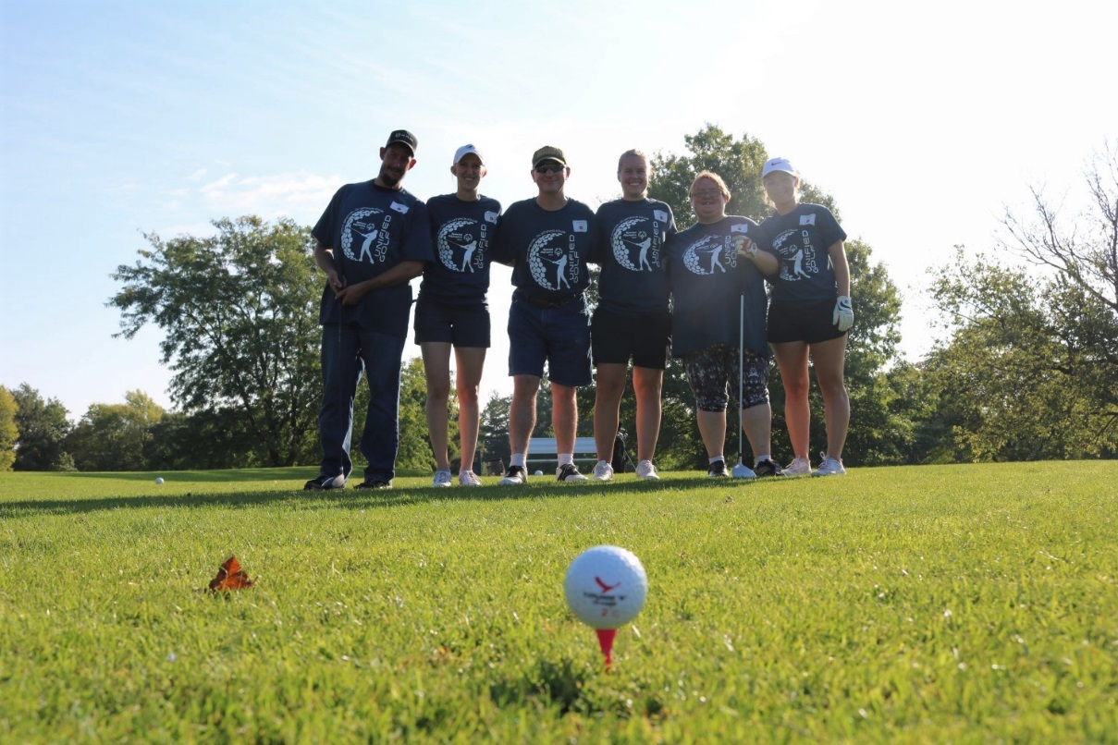
Unified Programs
Golf:
Cedar Falls
Cedar Rapids
Davenport
Des Moines
Muscatine
Sioux City
Spencer
Vinton
Waterloo
Unified Sports Days:
- Buena Vista University, Storm Lake
- Des Moines Public Schools, Des Moines
- Drake University, Des Moines
- Grinnell College, Grinnell
- Upper Iowa, Fayette
- University of Iowa, Iowa City
- Wartburg College, Waverly

Slide 17
Young Athletes Play Days
Ages 2 to 7
Strength, coordination & socialization
Introduction to Special Olympics
Great demand for program growth
Ankeny - AM
Ankeny - PM
Cedar Rapids
Council Bluffs
Davenport
Dubuque
Muscatine
Oskaloosa
River Hills – Spring
River Hills - Summer
Sioux City
West Des Moines
Notes:
Lack of socialization groups and medical professional, especially in rural areas
Allows the children and their families the ability to learn socialization and dexterity skills as well as develop support networks

Slide 18
Athlete Leadership Program (ALP)
Literacy
Leadership
Speaking Skills

Slide 19
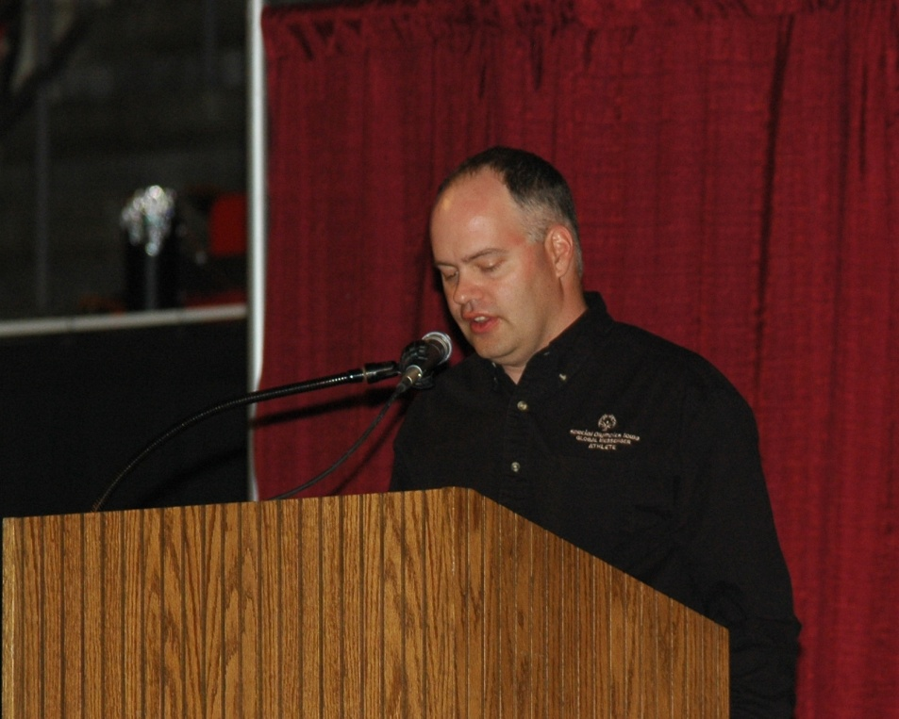
Athlete Leadership Workshop
Development of Leadership Roles
Service on:
Boards of Directors
Civic committees
Opportunities
Intern
Training/Educational
Employment

Slide 20
Global Messengers
Utilizes:
Phonics
Pictures and Signs
Other literary devices
Teaches athletes to deliver speeches
Social Interaction Opportunities
Civic/Community Involvement
Notes:
Global Messengers develop speaking skills to tell others what Special Olympics means to them and to their families

Slide 21
Healthy Athletes
Screening programs to improve greater overall health and fitness
Disciplines in:
- Fit Feet
- FIT Program
- FUN Fitness
- Health Promotions
- Healthy Hearing
- Med fest
- Opening Eyes
- Special Smiles
Title XIX does not provide dental or vision care
Offered at Summer Games and Mid-Winter Tournament
Notes:
Dedicated to serving the whole person and promoting overall physical health

Slide 22
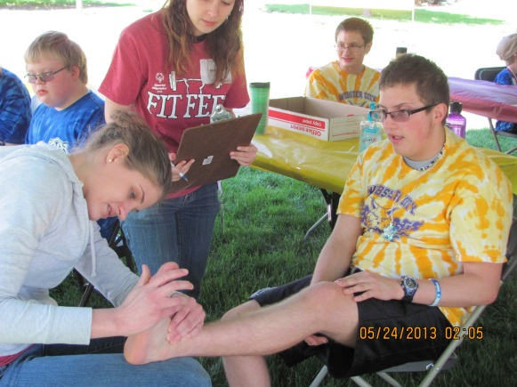
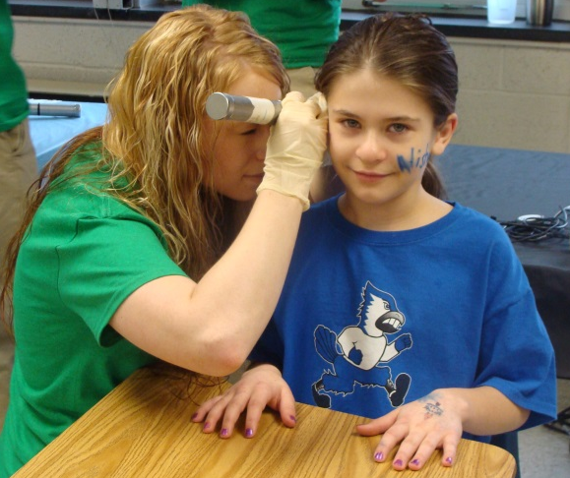
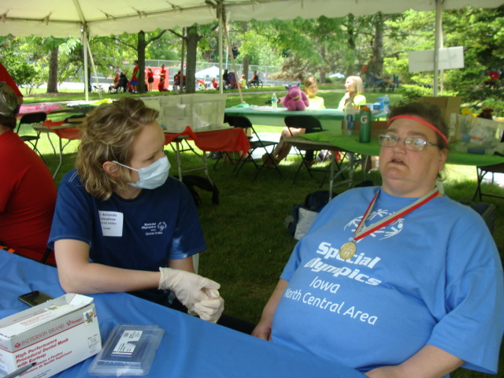
Healthy Athletes
771 Healthy Athlete Screenings
184 Healthy Athlete Volunteers
38 Doctors and Medical Professionals
38 FIT Assessments Completed
2017 Special Olympics Iowa Reach Report
Notes:
Dedicated to serving the whole person and promoting overall physical health

Slide 23
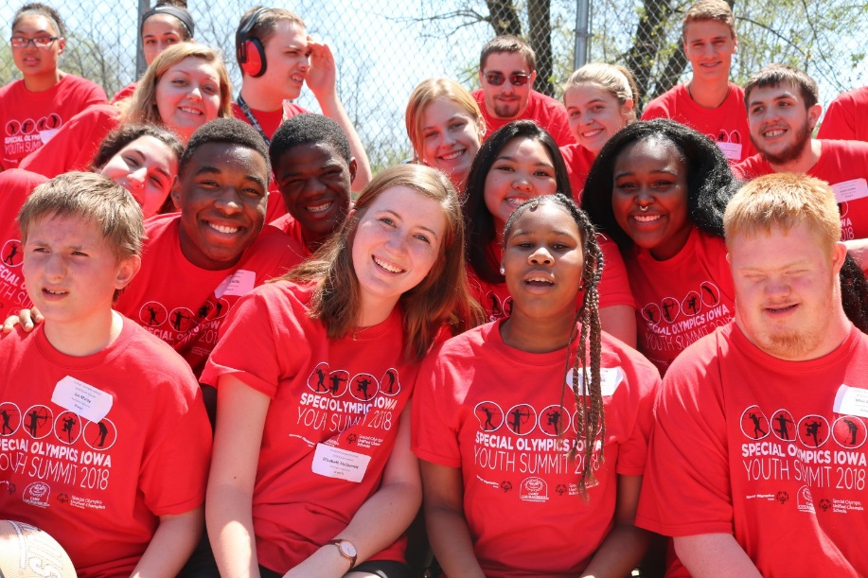
Unified Champion Schools
Funded in part by US Dept. of Education
Special Olympics Unified Champion Schools, formerly known as Project UNIFY®, brings together students with and without intellectual disabilities through education, sports and youth leadership to provide them with the knowledge, attitudes and skills necessary to create and sustain school communities that promote acceptance and respect.
Special Olympics Iowa partners with pre-schools, elementary schools, middle schools, high schools and colleges to implement or continue the three main components of the Unified Champion Schools® model. These components are:
Unified Sports: Allows students with and without intellectual disabilities the opportunity to participate in sporting activities alongside one another
Youth Leadership & Advocacy: Allows students with and without intellectual disabilities an opportunity to take on leadership roles which promote Unified activities in the school and community, while delivering the message behind these initiatives, which advocates for respectful and equitable treatment of all people
Whole-School Engagement: Allows opportunities for all students
to participate in Unified School programming through sustained
school-wide activities, which can include sports,
education, leadership and advocacy initiatives
Notes:
Dedicated to serving the whole person and promoting overall physical health

Slide 24
How & Where We Serve

Slide 25
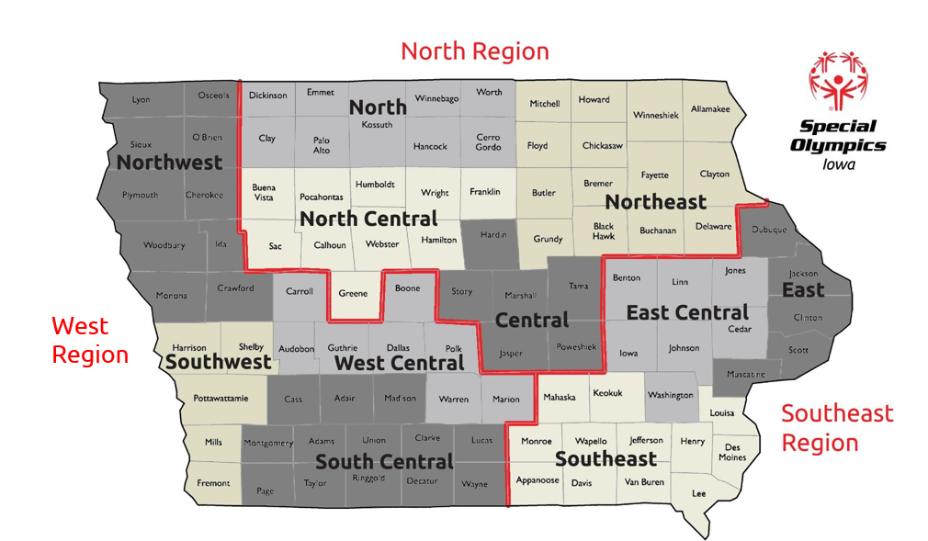
Area Directors

Slide 26
Volunteer Partners
Board
Up to 25 Board Members
Coaches
3,300+ Certified Coaches
Event & Program Volunteers
18,000+ Total Volunteers across the state
6,500+ Class A Volunteers

Slide 27
Funds and Fundraising

Slide 28
2018 Budgeted Revenue
The Board of Directors and staff of Special Olympics Iowa are committed to superior stewardship. 78.3 cents of every dollar contributed to our organization is spent on programs. There are NO charges for the athletes to participate in the competitions and events offered by Special Olympics Iowa.

Slide 29
Development
Relationship, Relationship, RELATIONSHIP
Have a Passion for the Mission
Fundraising Must Be a Focus
Understanding the Needs and Motivations of the Prospect

Slide 30
Statewide Partners
Premier Statewide Partners

Slide 31
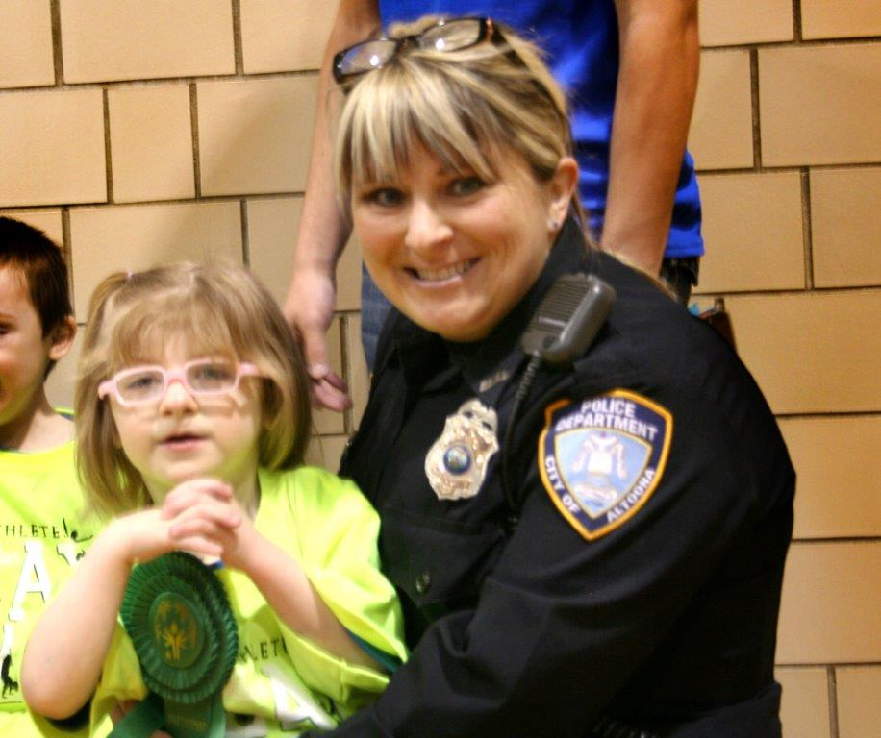
Law Enforcement Torch Run
Special Olympics is the charity of choice of the International Association of Chiefs of Police and law enforcement nationwide.
The Law Enforcement Torch Run of Iowa supports Special Olympics through year-round fundraising efforts conducted by law enforcement officials across the state.
1,100+ Law Enforcement volunteers in the State of Iowa.
The Law Enforcement Torch Run for Special Olympics Iowa raises more than $800,000 annually– the largest contributor.
Special Olympics LETR was initiated in 1981.

Slide 32
Messaging/Media

Slide 33
Notes:
SOIA works very hard to direct the maximum amount of resources directly to the athletes and their programs

Slide 34
Board of Directors

Slide 35
Functions of a Board
Organizational Planning / Updating Strategic Plan
Direction via a long range plan
Policy
A path to the long range plan
Finances
Current and future
Fundraising
Long range financial stability
Program Planning
Programs consistent with the needs of people we serve
Organizational Structure
Structure in place to enable SOIA to do its work
Public Education
Develop public trust, enhance public knowledge, enlist public support, attract leaders and volunteers.

Slide 36
Board Opportunities
Make a personal contribution
Acquire in kind donations
Attend board meetings
Volunteer at games/programs/events
Provide introductions/connections and/or attend calls to/with individual and corporate prospects
Chair a fundraising event
Sponsor or manage a venue
Committee Assignment

Slide 37
Board Forms/Training
Statement of understanding for SOIA Board of Directors
Volunteer screening
Class A volunteers (coaches, chaperones, anyone who is one-on-one with an athlete or in a position of authority relative to an athlete, anyone dealing with financial information)
Complete form
Take Protective Behaviors Training
Submit color photo
Receive volunteer credential
Process must be completed every 3 years

Slide 38
Tell Your Story
Why Special Olympics Iowa?

Slide 39
Welcome to the Special Olympics Iowa Family!

Slide 40
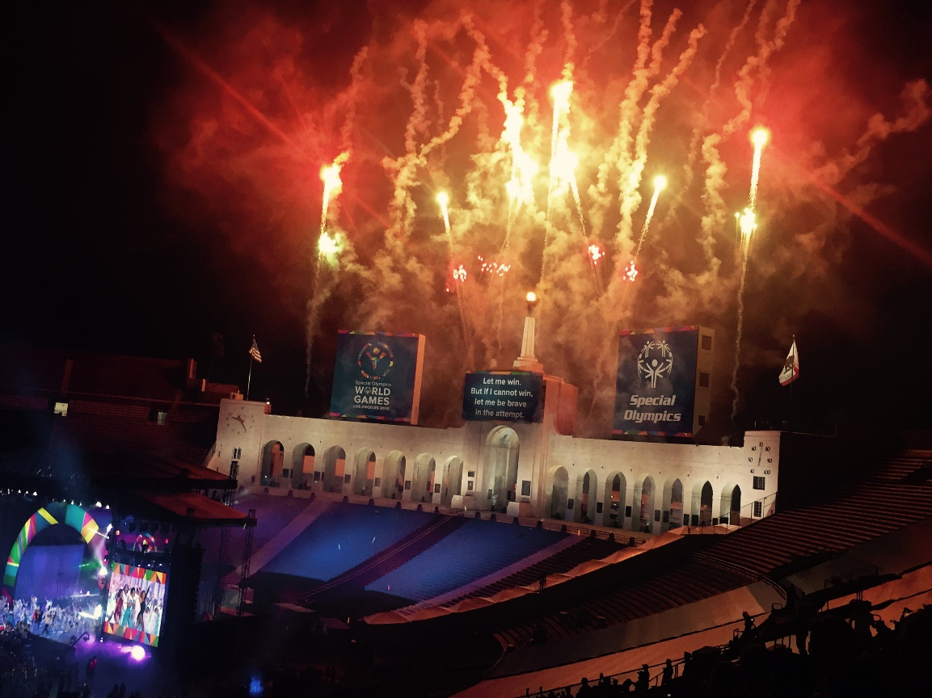
“Let me win.
But if I cannot win,
Let me be brave in
the attempt.”
Special Olympics Athlete Oath
Notes:
Thank you for your time - Questions?

