Slide 1
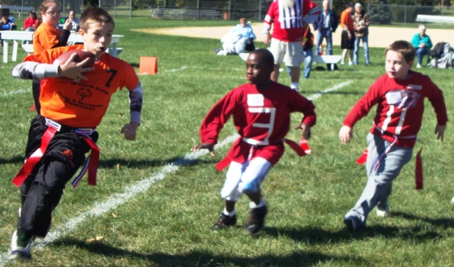
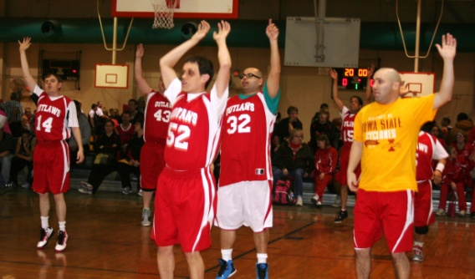
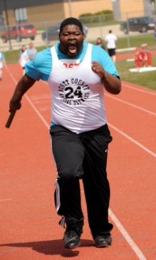
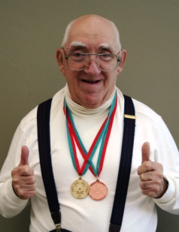
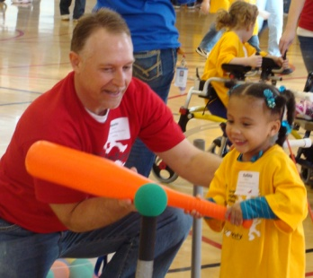
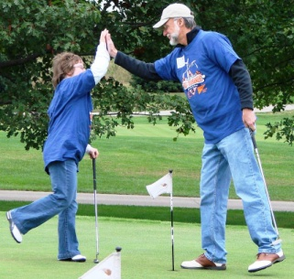
Strategic Plan
Committee Priorities for 2016
Revealing the champion in all of us.

Slide 2
Process Reminder from 2015
Committees met to generate ideas for greater engagement/involvement
Ideas generated were discussed by a group consisting of all committee chairs
Two main goals were identified in that meeting
Additional “Board Associates” were identified to help the committees toward their goals

Slide 3
Ideas Generated – Fall 2015
Increase participation opportunities including athletic, unified sports and healthy athletes.
Expand the healthy athlete program to all large state championships and expand Med Fest events to various locations throughout the state.

Slide 4
Other Committee Ideas – Fall 2015
Finance and Human Resources
Add HR responsibilities to the Finance Committee
Develop an executive summary financial report for the Board to accompany the detail – goal to make the financials easier to understand

Slide 5
Other Committee Ideas – Fall 2015
Governance and Board Development
By-law revisions
Board election process and appointment of Board Associate membership

Slide 6
SOIA Strategic Plan 2014-18
We also want to re-visit our Strategic Plan that was set forth in 2014 (A copy has been provided to you for this meeting)
A lot has changed since that time, but we don’t want to lose sight of that Plan
It is KEY that we have a secure foundation upon which to grow SOIA

Slide 7
Special Olympics Iowa Summarized
Strategic Priorities
Athlete Experience
Advance Quality Sports & Competitions
Enhance competition opportunities at the local level
Focus on consistent standards and rule application at all levels
Build Communities
Expand Unified Sports
Target program penetration as area of growth and expansion
Utilize sports to leverage partnerships, grow athlete and volunteer base, and enhance public awareness of SOIA
Connect Fans & Funds
Build a comprehensive fundraising program
Leverage LETR into local and area fundraising opportunities
Develop innovative, fundraising events that connect with new audiences
Develop Movement Leadership
Define current roles of leadership team
Develop staffing plan that reflects vision and priorities of organization
Encourage excellence through advanced education and training
Establish Sustainable Capabilities
Infrastructure Assessment
Review current data management
Develop and implement inclusive Volunteer Management System
Special Olympics Foundation:
Mission, Values and Model of Change

Slide 8
Additional Carry-Over Ideas
Support of new management
How can we help stabilize SOIA
How can we help the VP-Programming
How can we help the VP-Development
Board reporting of volunteer hours, etc

Slide 9
Today’s Brainstorming Session
Discuss ideas from last fall and Strat Plan
Are those still our goals?
What new goals do we have?
What information can we provide at the Retreat to help move these ideas forward?

Slide 10
Next Steps
Take the Goals we agreed upon for 2016
Expand on those at the Retreat on March 1
Set specific goals for each committee at the Retreat
Determine how to measure our results/success

